Slide 1
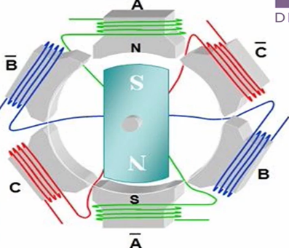
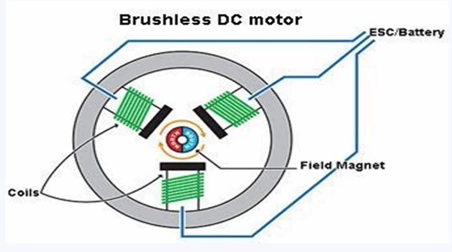
Types of BLDC Motors
2. In-runner type BLDC Motor
Rotor is inside and stator is outside
It requires transmission
It is little bulky
Used in three wheelers & two wheelers like Ather 450

Slide 2
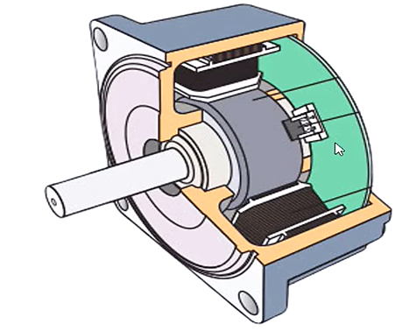
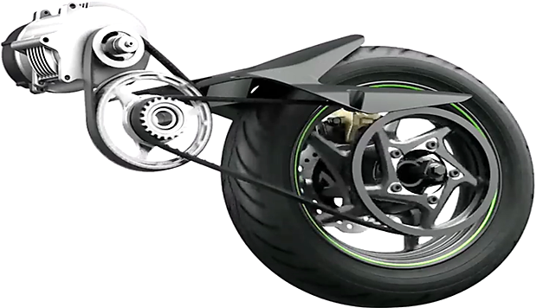
Types of BLDC Motors
Ather 450 In runner BLDC Motor

